Slide 1
Server Side

Slide 2
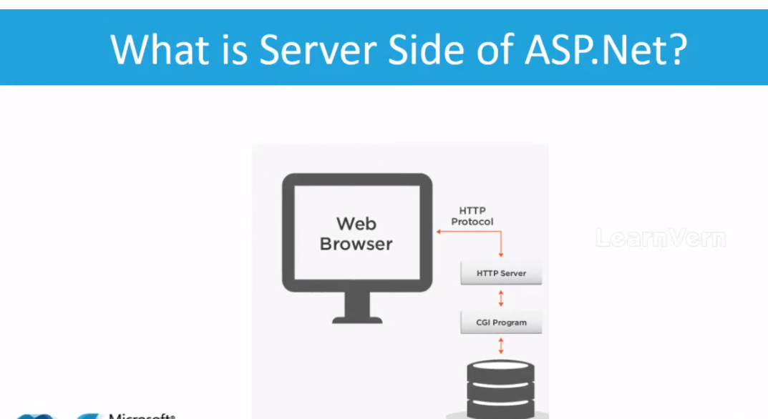



Slide 3
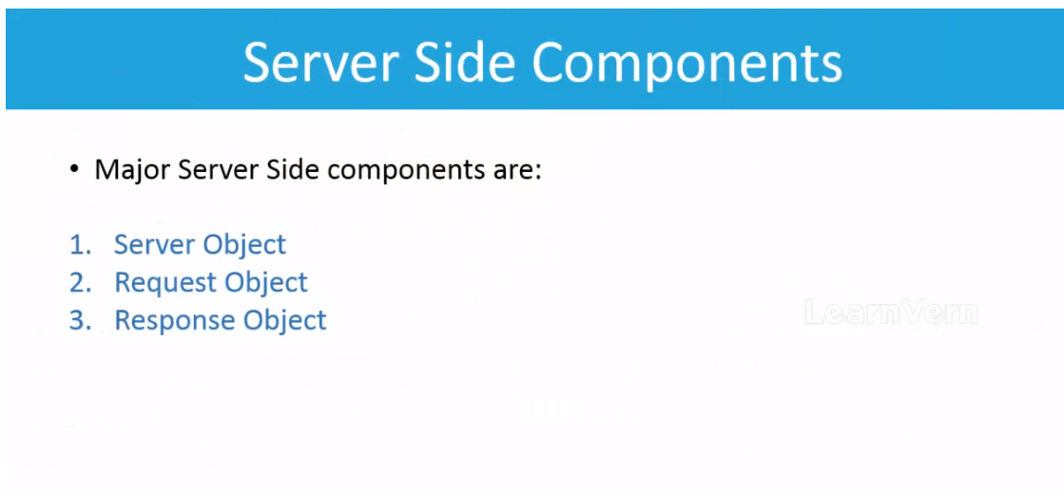

Slide 4
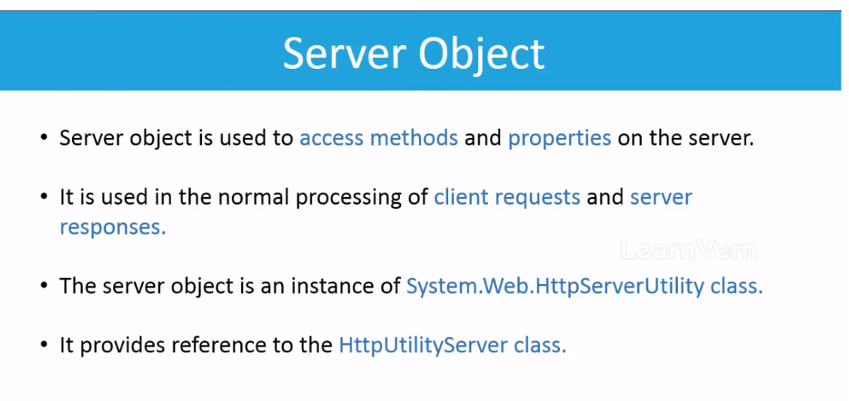

Slide 5
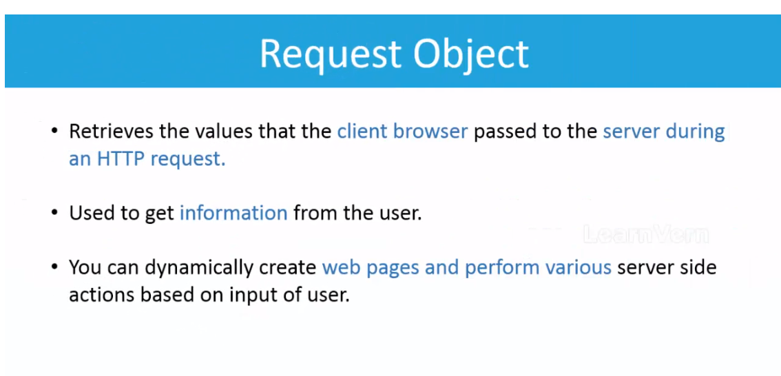


Slide 6
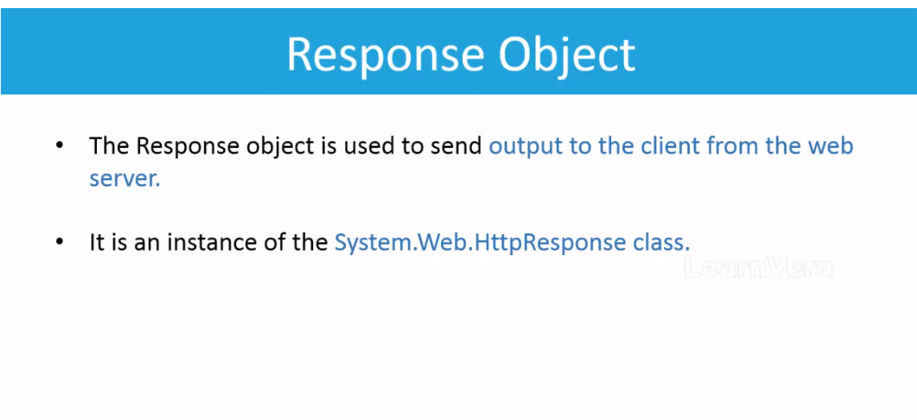

Slide 7
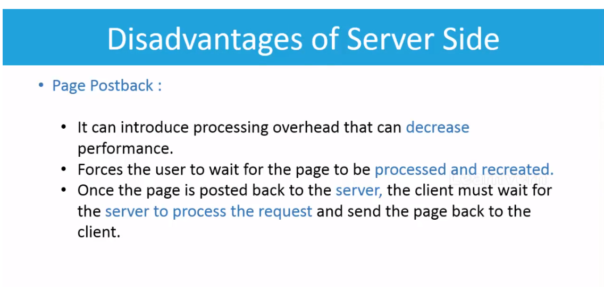

Slide 8
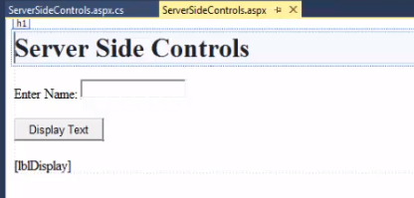
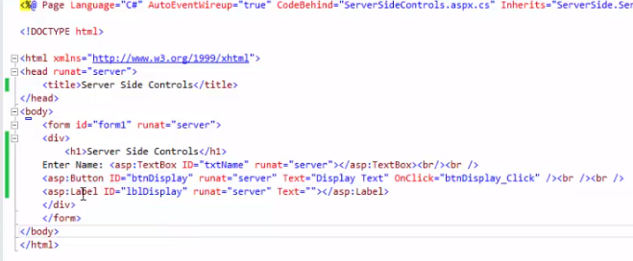
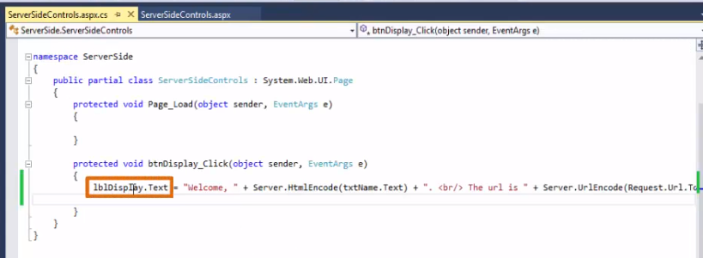
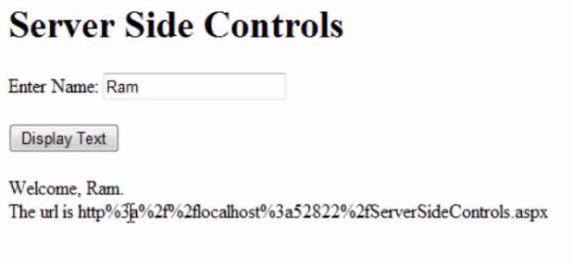
Example
Output

Slide 9
Difference between Server.Execute() vs Response.Redirect() vs Server.Transfer()
Server.Execute() when called it loads the content of the called page along with it the content of the calling page still displays, but the url of the calling page still displays.
Response.Redirect() when called, it completely redirects to the calling page, displaying the URL and the content of the called page.
Server.Transfer() when called, it doesn’t change the URL of the calling page but shows only the content of the calling page.

Slide 10
ASP.NET Controls
The two types of controls in Asp.net are:
Server Controls aka Html Controls
Client Controls

Slide 11
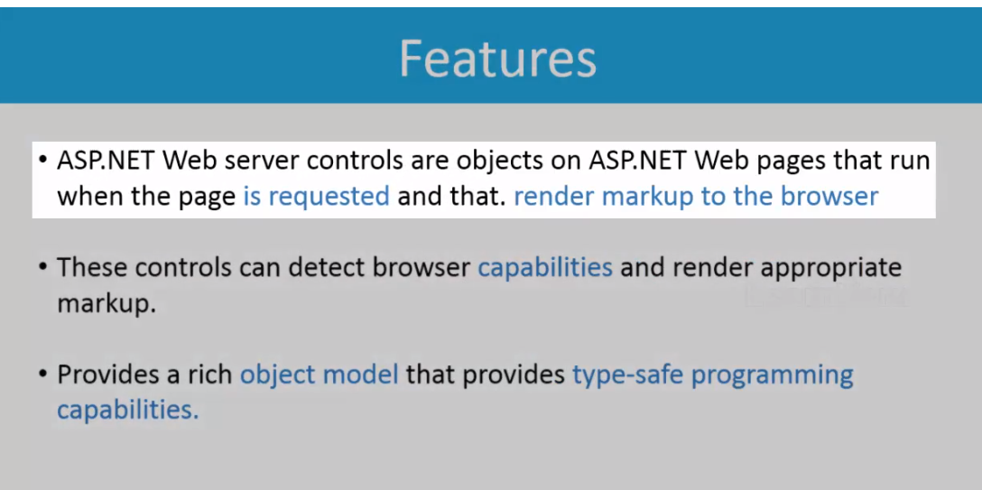
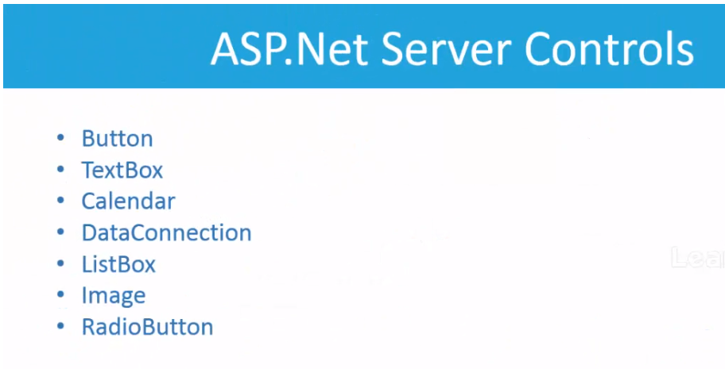

Of Web Server Control

Slide 12
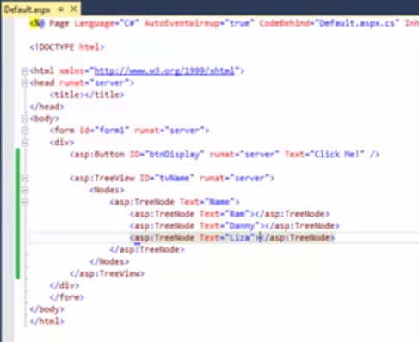
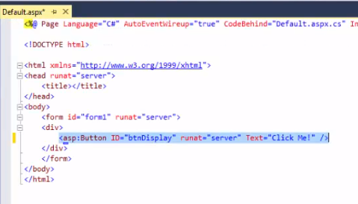
Example

Slide 13
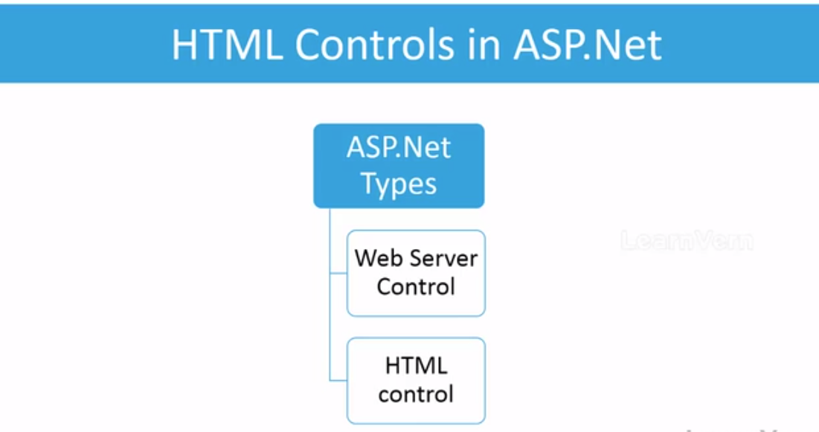

Slide 14
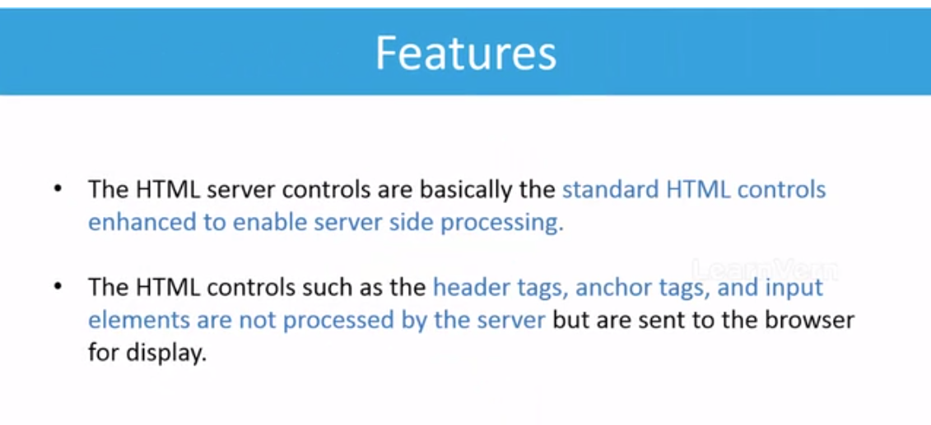



Slide 15
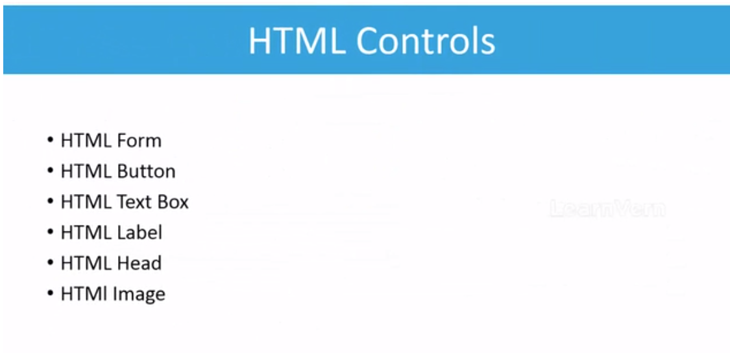

Slide 16
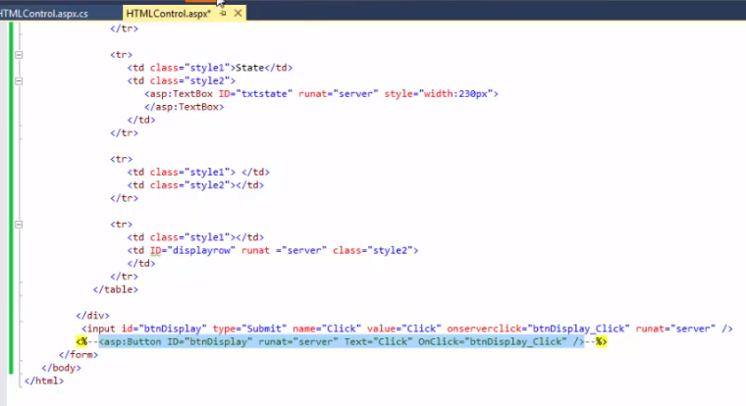
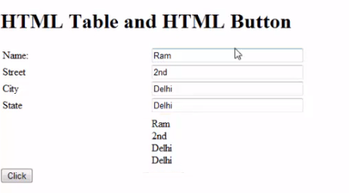
Example
Output

Slide 17
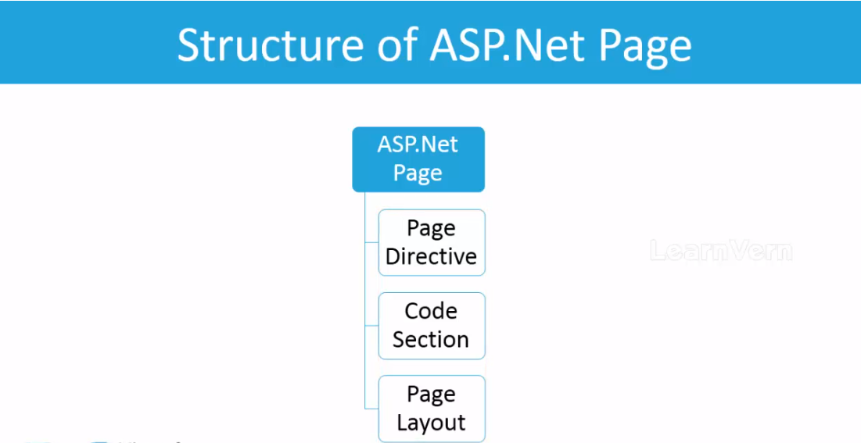

Slide 18
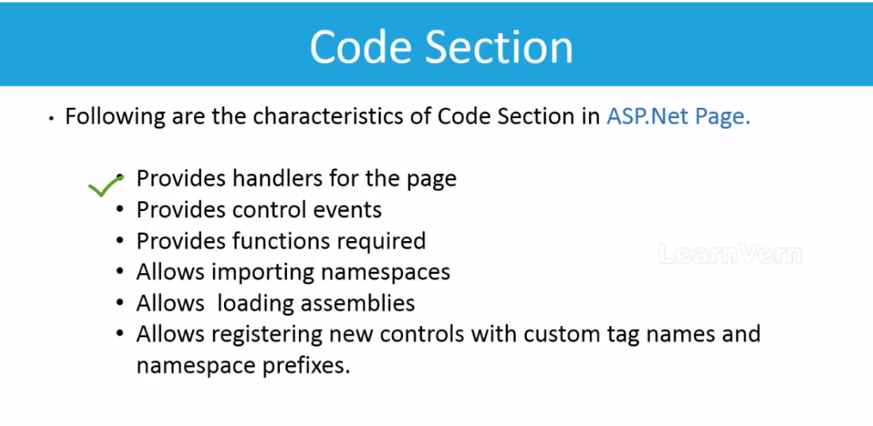

Slide 19
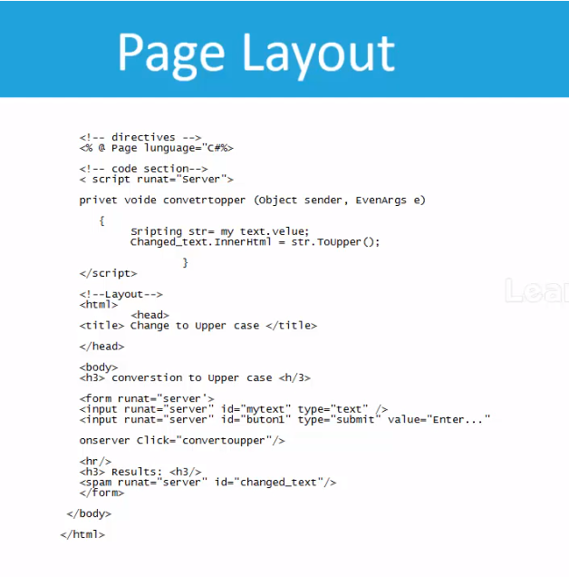
Example

